Slide 1
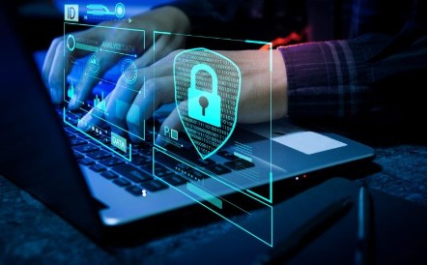
24k-3109 Bilal Ahmad
Why Cyber security is important?
Keeping our Information safe.

Slide 2
What is Cyber Security?
Definition: Cybersecurity means protecting computers and data from bad people.
Purpose: It helps keep our information safe and stops attacks on systems.
Key Ideas:
Confidentiality: Only certain people can see sensitive information.
Integrity: Information must not be changed by anyone who shouldn’t.
Availability: Information should be easy to access when needed.

Slide 3
Types of Cyber threats:
Common Threats:
Malware: Bad software that harms computers.
Phishing: Fake emails that try to steal personal information.
Ransomware: Software that locks files and asks for money
to unlock them.
Growing Problem: Cyber threats are becoming more common
every day.

Slide 4
Growing Cyber Threat Landscape
Cybercrime is projected to cost the world $10.5 trillion annually by 2025, making it one of the fastest-growing crimes.
The frequency of cyberattacks has increased by over 400% since the pandemic began.

Slide 5

Effects of Cyberattacks
Financial Loss: Companies can lose a lot of money from attacks.
Disruption: Cyberattacks can stop businesses from working properly.
Personal Impact: People can lose money and personal information, which can be very stressful.
VIDEO DESCRIBING THE CYBERCRIME MAKING ILLEGAL TRANSACTIONS

Slide 6
Why Businesses Need Cybersecurity:
Build Trust: Good security helps customers feel safe with their information.
Follow Laws: Many laws require businesses to protect data.
Stay in Business: Companies that protect themselves can recover faster from attacks.

Slide 7
Why Individuals Need Cybersecurity:
Protect Yourself: Keep your personal information safe online.
Be Aware: Learn about scams to avoid falling for them.
Manage Your Digital Footprint: Be careful about what you share online.

Slide 8
Basic Cybersecurity Tips:
Use Strong Passwords: Make passwords hard to guess.
Update Software: Regularly update programs to fix security problems.
Be Educated: Learn about online safety and share this knowledge with others.
Press cntrl and then click on this activity to attempt it.

Slide 9
Conclusion:
Summary: Cybersecurity is essential for protecting both individuals and organizations from increasing digital threats
Call to Action: Stay informed about cybersecurity trends, adopt best practices, and make security a priority in everyday digital activities.

Slide 10
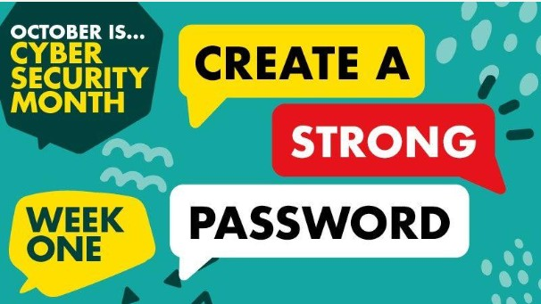
Scenario based activity
Password Strength Assessment
Scenario: You and your friends are discussing your passwords. Some friends say they use simple passwords like "123456" or "password."
Questions for Discussion:
Why are these passwords weak?
What makes a password strong?
Create a strong password using a combination of letters, numbers, and symbols.
Objective: To understand the significance of strong passwords and practice creating them.
DESCRIPTION: ASKING CLEARLY TO CREATE A STRONG PASSWORD.

